Slide 1
Respiratory Physiology
By:
Dr. Nicholas Ochieng’
Clinical Medicine Department
KMTC, Machakos

Slide 2
What to cover in this session
Definitions and anatomy of R/S
Functions of respiration
Mechanics of breathing
Measurements of pulmonary function
Cellular Respiration, Pulmonary disorders
Blood gases - Diffusion
Control of respiration
Transport of O2 and C0₂
Acid/base balance
Diseases of R/S

Slide 3
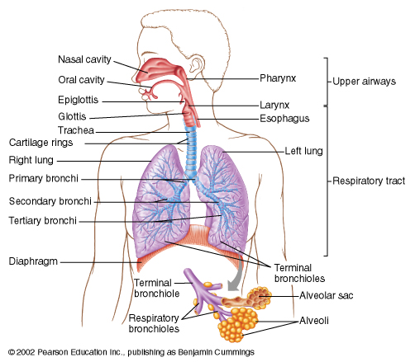
Anatomy review

Slide 4
Functional anatomy of respiratory system
Nose or Mouth Pharynx Larynx
Trachea Bronchi Smaller Bronchi
Terminal Bronchioles
Respiratory Bronchioles Alveolar Ducts
Alveolar sacs Alveoli

Slide 5
Functions of Respiratory System
Exchange of gases between atmosphere and the blood
Homeostatic regulation of body pH
Protection from inhaled pathogens and irritating substances
Lungs contain lymphocytes, plasma cells and macrophages
Vocalization
Loss of water and heat from body
It enhances venous return ( Respiratory pump)
The nose as a part of respiratory system, serves as the organ of smell
Lungs synthesize certain prostaglandins, histamine, heparin and kallekrein
Pulmonary capillary endothelial cells contain Angiotensin converting enzyme
Lungs act as reservoir of blood
Lungs synthesize surfactant
Pulmonary vessels can trap fat cells, small clots and detached cancer cells and thus prevent their entry into systemic circulation

Slide 6
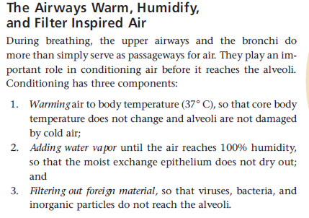

Slide 7
What is respiration?
  Synonym: Ventilation
  Definition
    Action of breathing during which Gaseous exchange takes place ie Oxygen is taken and Carbon dioxide is removed by the lungs
    Gaseous exchange takes place between air and capillaries (Alveoli) in the lungs (External respiration).
    Between systemic capillaries and tissues of the body (Tissue respiration) also called internal
    Oxygen utilization:
    Cellular respiration takes p[lace in mitochondria

Slide 8
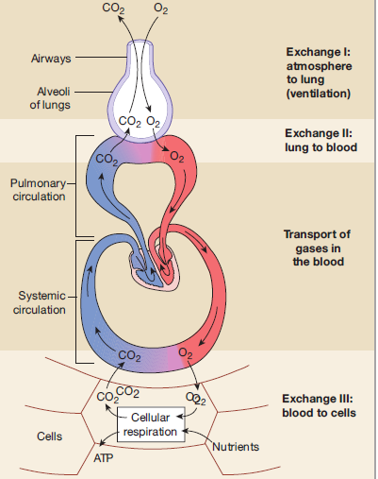
Internal(Cellular) and External Respiration

Slide 9
External Respiration
Movement of air from environment / atmosphere to lungs/ alveoli
From alveoli to blood
Transport in the blood
From blood into cells
Regulation of respiration

Slide 10
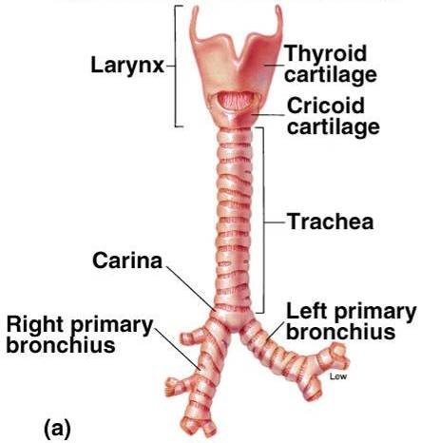
Conducting zone

Slide 11
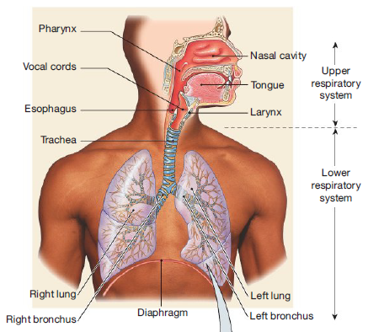
Branching of the airways

Slide 12
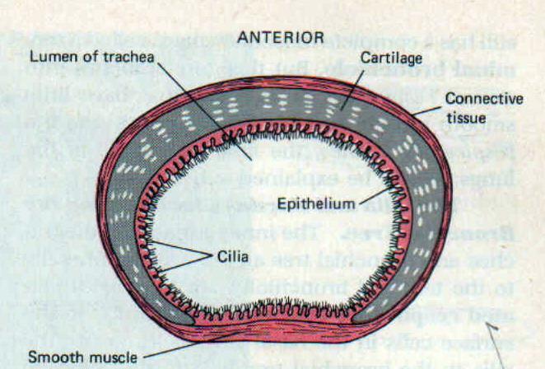
Cross sectional view of trachea

Slide 13
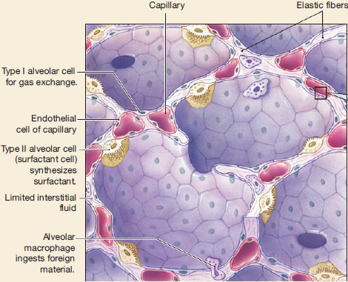
Alveolar Structure

Slide 14
Number of alveoli & their capacity
There are:
8 million alveolar ducts
300 million alveoli (diameter 70-300 μm)
Total alveolar surface area (Average) ~ 70 m²
Alveolar membrane thickness < 1 μm.

Slide 15
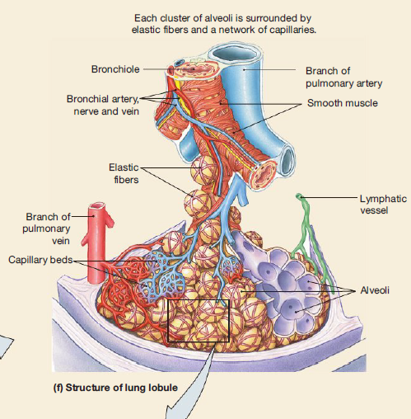

Slide 16
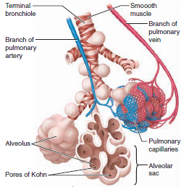

Slide 17
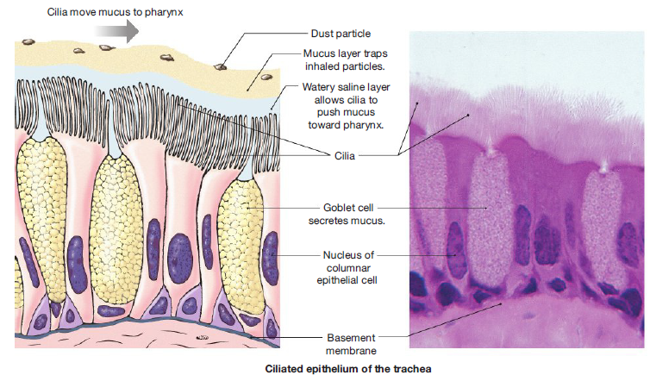
Mucus Escalator

Slide 18
What are alveoli?
Alveoli are thin-walled, Inflatable, grapelike sacs at the terminal branches of conducting airways
Each contain single layer of epithelial cells
Epithelial cells are two types:
(a) Type I cells (Pneumocyte type I ) For gas exchange , large and occupy 95% of alveolar surface area
(b) Type II cells (Pneumocyte type II ) Secrete surfactant ( small cells)
Other cells in the lungs Alveolar macrophages

Slide 19
The Pleura and pleural sacs
It is a double- walled closed sac that separates each lung from the thoracic wall and other surrounding structures
It contains pleural sacs
Two types of pleura:
(1) Visceral Pleura
(2) Parietal Pleura

Slide 20
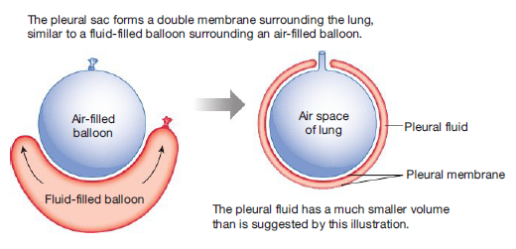
Relationship between pleural sac & the lung

Slide 21
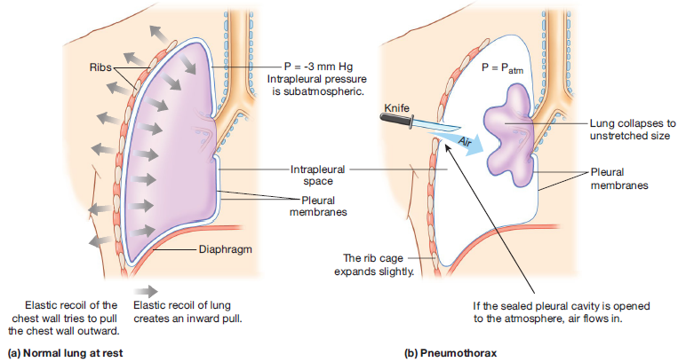
Pneumothorax

Slide 22
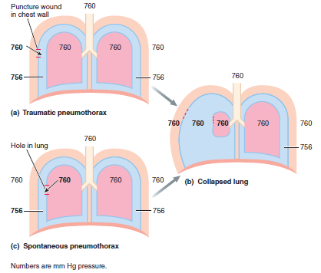

Slide 23
Gas Laws
.
The total Pressure of a mixture of gases is the sum of the pressures of the individual gases (Dalton’s Law)
Gases, singly or in a mixture, move from areas of higher pressure to areas of lower pressure.
If the volume of a container of gas changes, the pressure of the gas will change in an inverse manner ( Boyle’s Law)
The amount of a gas that will dissolve in a liquid is determined by the partial pressure of the gas and the gas’s solubility in the liquid

Slide 24
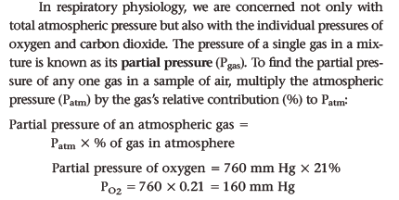

Slide 25
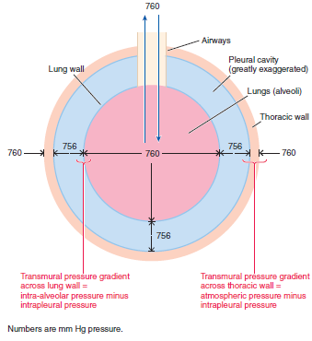
Transmural pressure gradient

Slide 26
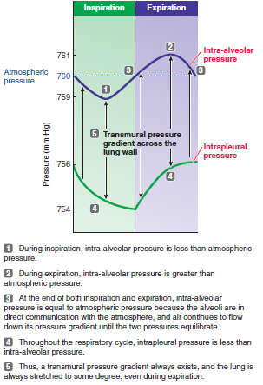
Pressures in Respiratory system

Slide 27
Pulmonary Ventilation
Pulmonary ventilation is defined as inflow & outflow of air between the atmosphere & the lung alveoli
Inflow → Inspiration
Outflow → Expiration

Slide 28
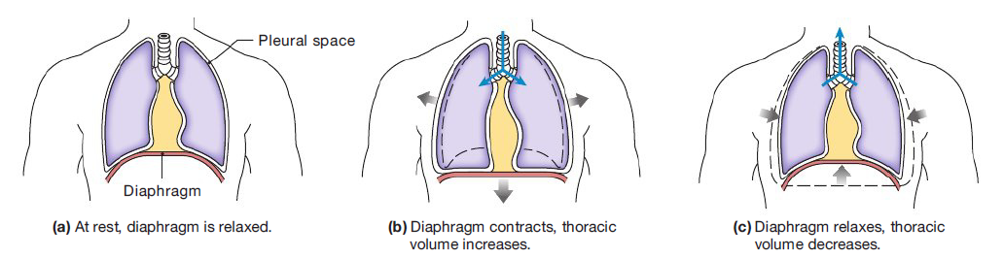
Role of Diaphragm

Slide 29
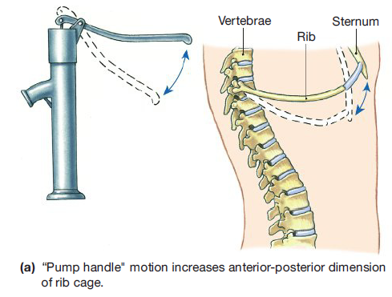
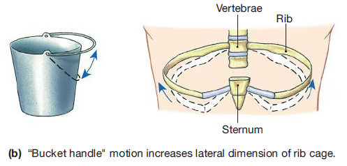
Movement of rib cage during Inspiration

Slide 30
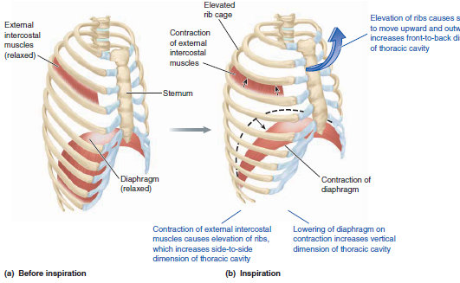

Slide 31
Mechanism of Inspiration
Contraction of Diaphragm Contraction of Chest elevating muscles
Increase in vertical dimension of Thorax Increase in antero-posterior (mostly) and transverse dimensions of thorax
Pulling of the lungs outward and downward
Expansion of lungs
Decrease in intrapulmonary pressure
Establishment of pressure gradient from atmosphere to alveoli
Start of inspiration
Intrapulmonary pressure becomes equal to atmospheric

Slide 32


Slide 33
Mechanism of Expiration.
Relaxation of inspiratory muscles
Decrease in size of thorax
Compression of lungs
Decrease in size of lungs
Increase in intrapulmonary pressure
Establishment of pressure gradient from alveoli to atmosphere
Start of Expiration
Intrapulmonary pressure becomes equal to atmospheric Pressure
End of expiration

Slide 34
      Muscles of Inspiration
      External Intercostals
      Sternocleidomastoid
      Anterior serrati
      Scaleni
      Muscle of Expiration
      Abdominal Recti
      Internal Intercostals
      Other Abdominal Muscles

Slide 35
Diseases of R/S
Restrictive disorder:
  Vital capacity is reduced
  Less air in lungs or low residual volume
  Eg: Black lung from coal mines
  Pulmonary fibrosis: Tuberculosis
  too much connective tissue
Obstructive disorder eg - COPD
  Rate of expiration is reduced
  Lungs are “fine,” but bronchi are obstructed

Slide 36
Obstructive disorders
COPD (chronic obstructive pulmonary disease):
Smoking is the main cause for COPD
  Asthma
  Emphysema
  Chronic bronchitis

Slide 37
Disorders contd
Air/ Fluid in the pleural space
  Pneumothorax
  Hydrothorax
  Pyothorax
  Hydropneumothorax

Slide 38
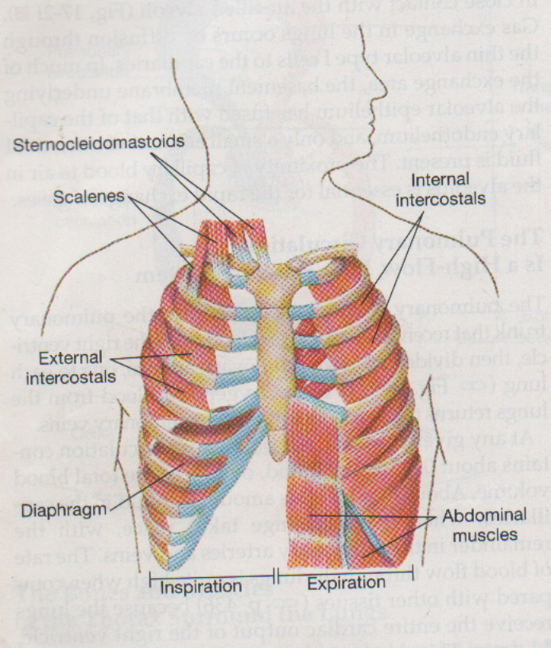
Respiratory Muscles

Slide 39
Tissue respiration
O2 take up & CO2 release

Slide 40
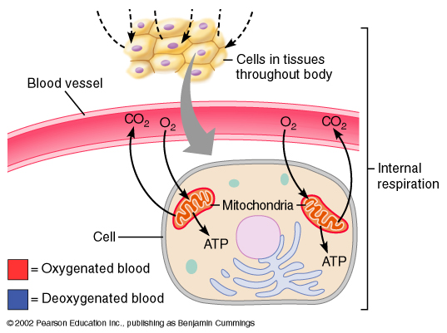
Cellular respiration

Slide 41
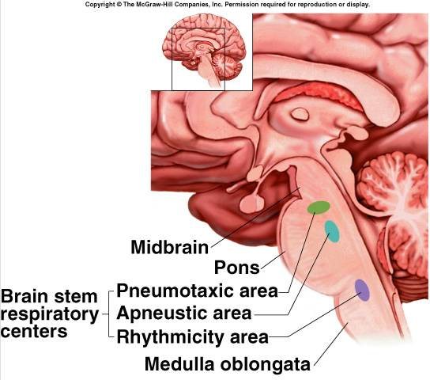
Control of respiration
Neural:
Respiratory centers
In hindbrain
  - medulla oblongata
  - pons
Automatic breathing

Slide 42
Chemo-receptors
  Oxygen: large “reservoir” attached to hemoglobin.
  So chemo-receptors are more sensitive to changes in P_{C02} (as sensed through changes in pH).
  Ventilation is adjusted to maintain arterial PC0₂ of 40 mm Hg.
  Chemo-receptors are located throughout the body (in brain and arteries).

Slide 43
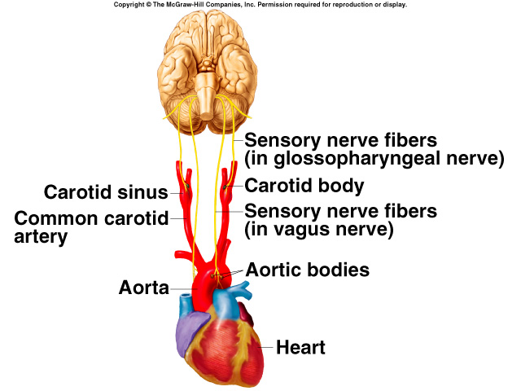
Location of chemoreceptors

Slide 44
Acid - base balance conditions
Ventilation is normally adjusted to keep pace with metabolic rate, so homeostasis of blood pH is maintained.
Normal blood pH range: 7.35- 7.45 (Aver = 7.4)
In Alkalosis: pH rises while in Acidosis: the pH goes down (H₂0 + C0₂)
Hypoventilation:
  PC0₂ rises, pH falls (acidosis).
Hyperventilation:
  PC0₂ falls, pH rises (alkalosis).

Slide 45
Acid base balance contd
Hyperventilation -> PC0₂ down -> pH of CSF up -> vasoconstriction -> dizziness.
If hyperventilating, should you breathe into paper bag? Yes! It increases PC0₂!
Above can be triggered by acidosis
Diarrhoea -> acidosis
Vomit -> alkalosis

Slide 46
Other functions of respiration
BEHAVIORAL- talking, laughing, singing, reading
METABOLIC- forms angiotensin II, prostacyclin, bradykinin, serotonin and histamine
MISCELLANAEOUS- enables the body to lose heat and water, liquid reservoir for blood, force generation for lifting, vomiting, defaecation and childbirth

Slide 47
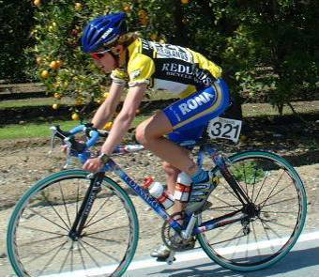
THE END
THANK YOU

